Slide 1


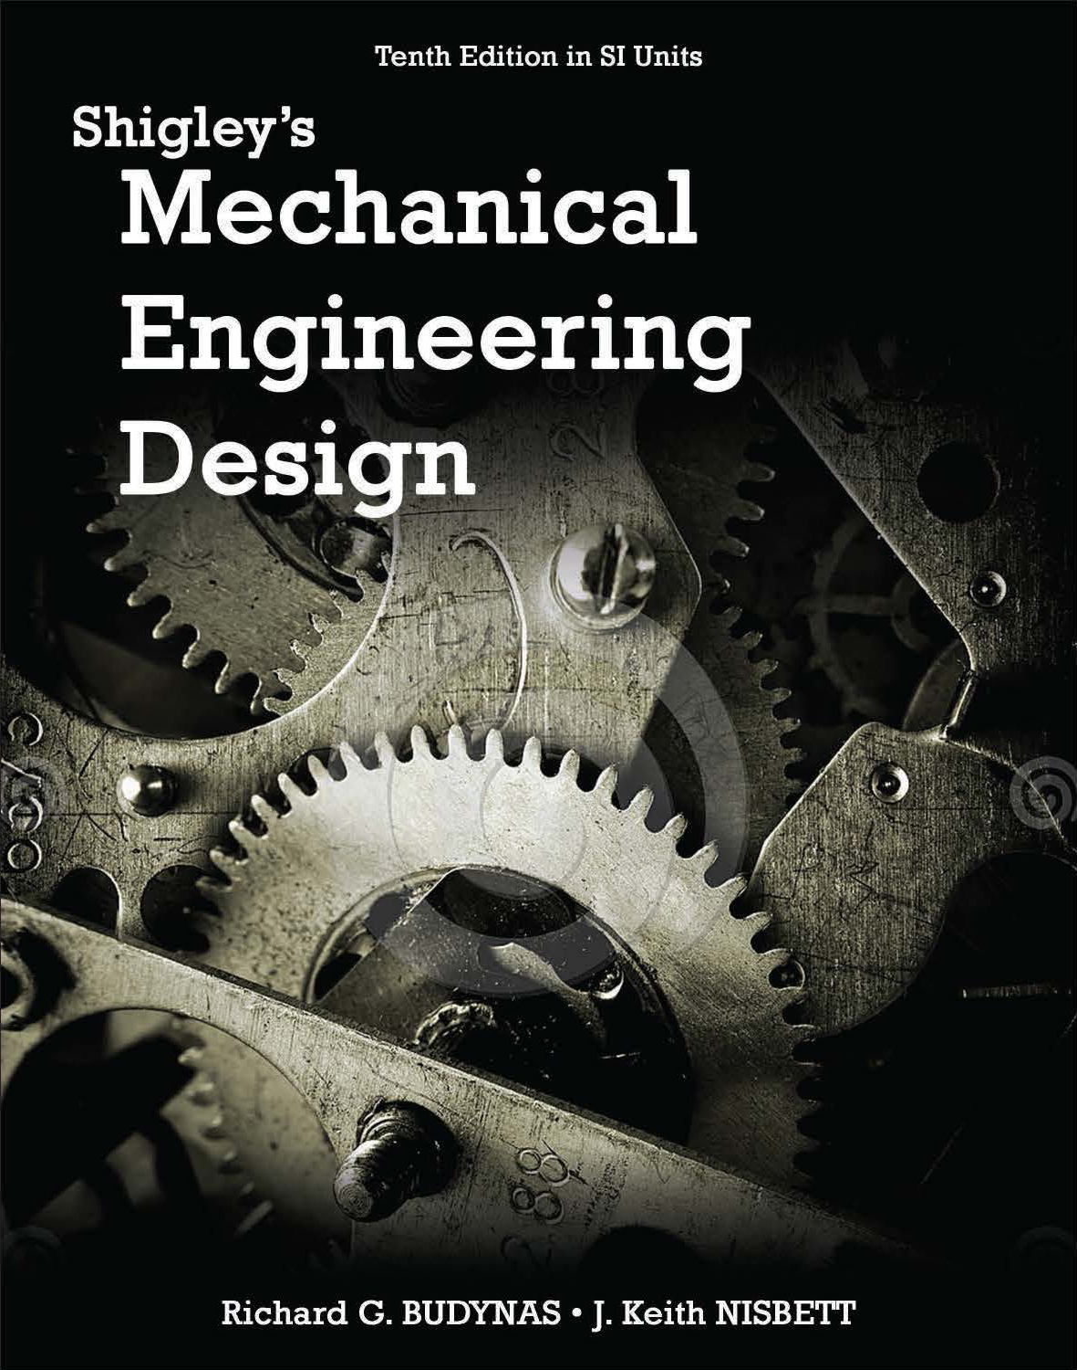
Lecture Slides
Chapter 3
Load and Stress Analysis
© 2015 by McGraw-Hill Education. This is proprietary material solely for authorized instructor use. Not authorized for sale or distribution in any manner. This document may not be copied, scanned, duplicated, forwarded, distributed, or posted on a website, in whole or part.

Slide 2
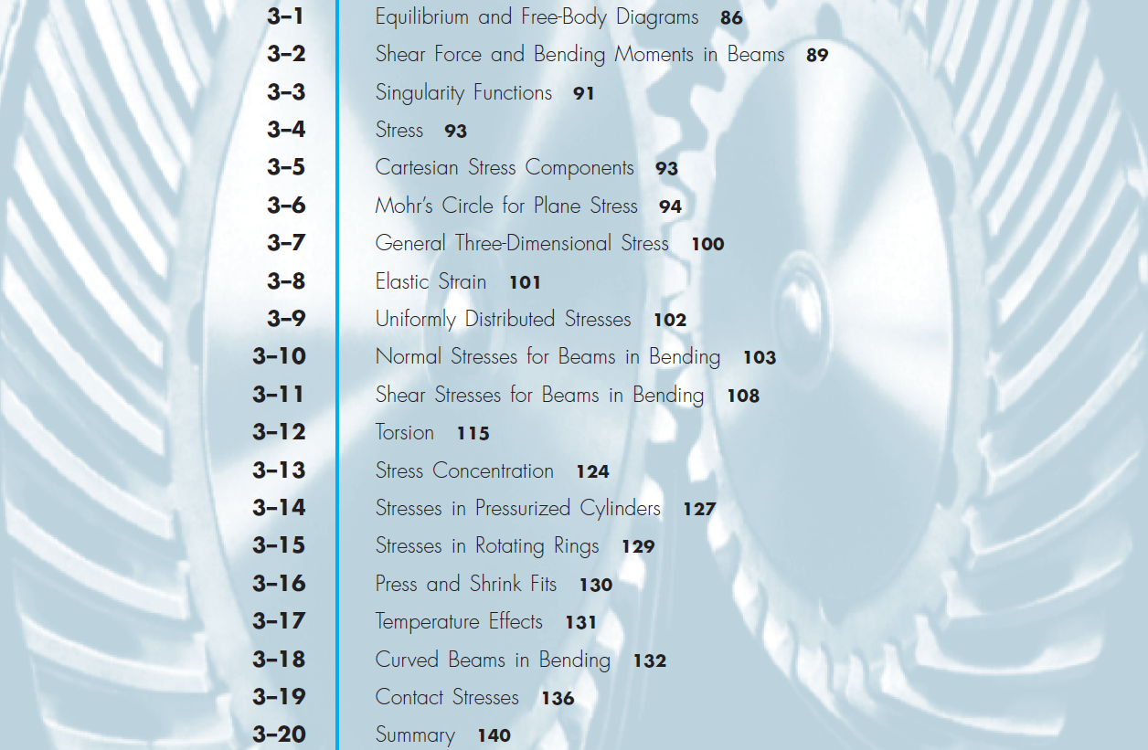
Chapter Outline

Slide 3
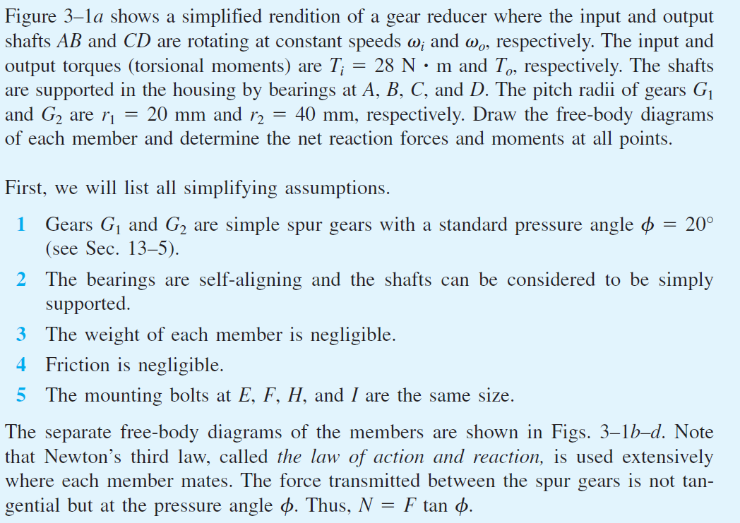
Free-Body Diagram Example 3–1

Slide 4
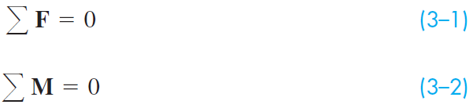
Equilibrium
A system that is motionless, or has constant velocity, is in equilibrium.
The sum of all force vectors and the sum of all moment vectors acting on a system in equilibrium is zero.

Slide 5
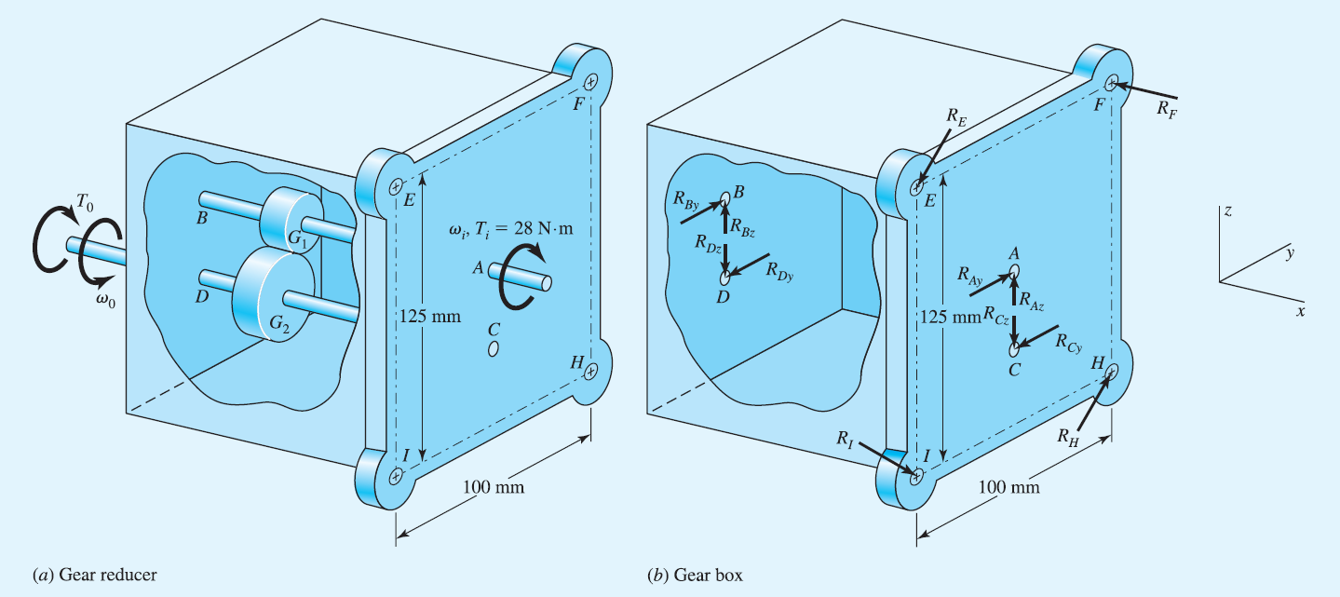
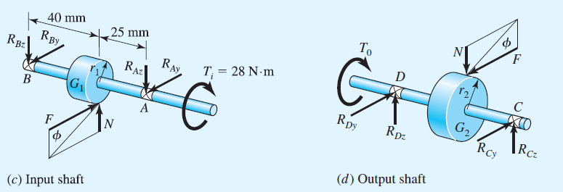
Free-Body Diagram Example 3–1
Fig. 3–1

Slide 6
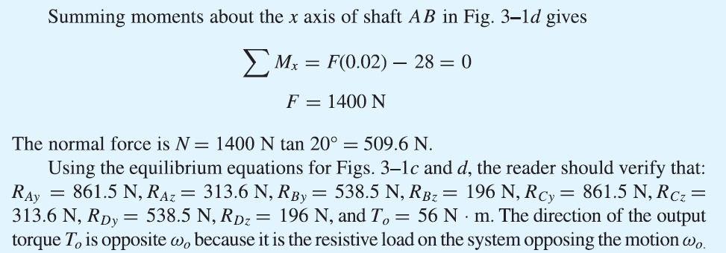
Free-Body Diagram Example 3–1

Slide 7
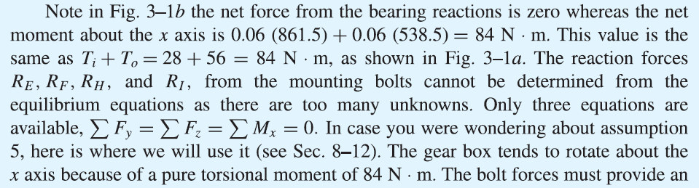
Free-Body Diagram Example 3–1

Slide 8
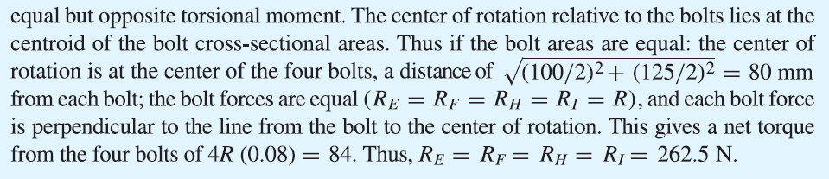
Free-Body Diagram Example 3–1

Slide 9
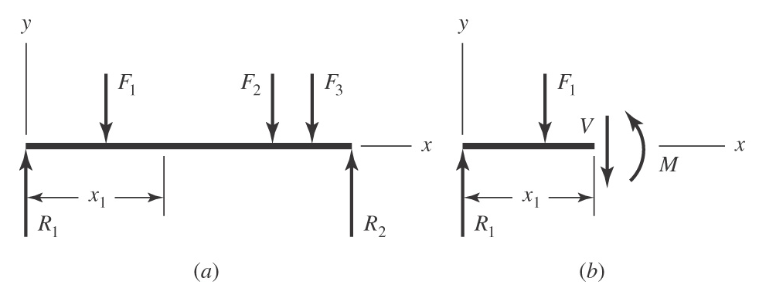
Shear Force and Bending Moments in Beams
Cut beam at any location x₁
Internal shear force V and bending moment M must ensure equilibrium
Fig. 3−2

Slide 10
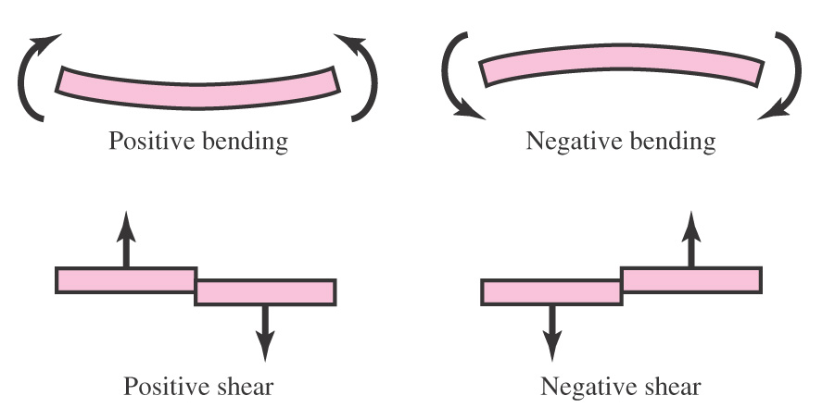
Sign Conventions for Bending and Shear
Fig. 3–3

Slide 11
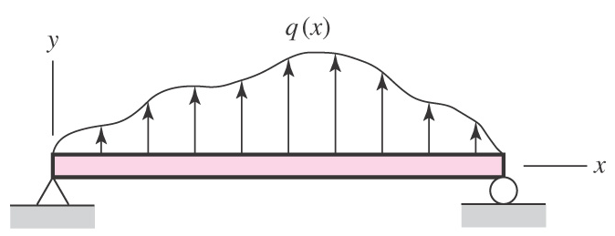
Distributed Load on Beam
Distributed load q(x) called load intensity
Units of force per unit length
Fig. 3–4

Slide 12
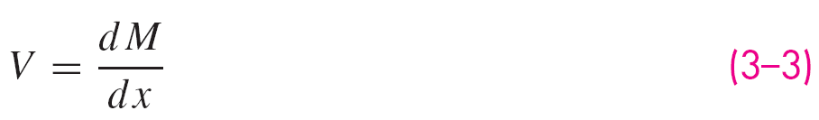
Relationships between Load, Shear, and Bending
The change in shear force from A to B is equal to the area of the loading diagram between x_{A} and x_{B}.
The change in moment from A to B is equal to the area of the shear-force diagram between x_{A} and x_{B}.

Slide 13
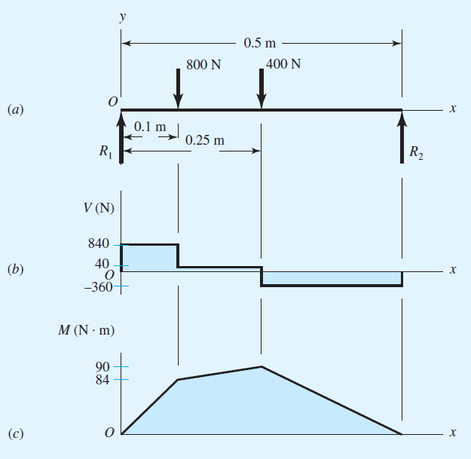
Shear-Moment Diagrams
Fig. 3–5

Slide 14
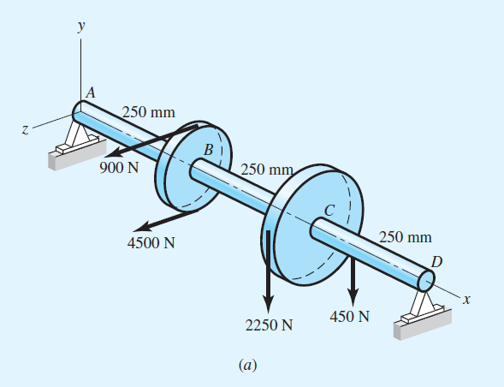
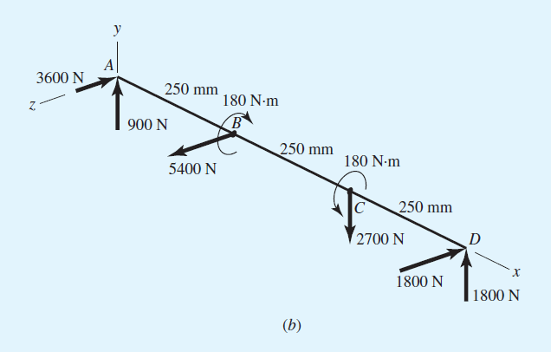
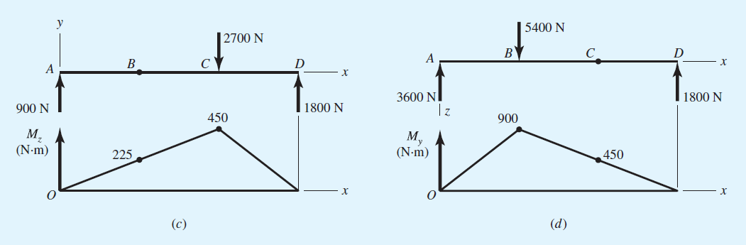
Moment Diagrams – Two Planes
Fig. 3–24

Slide 15
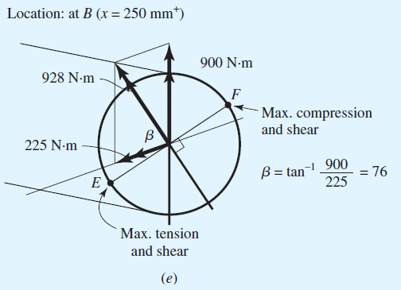
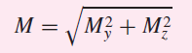
Combining Moments from Two Planes
Add moments from two planes as perpendicular vectors
Fig. 3–24

Slide 16
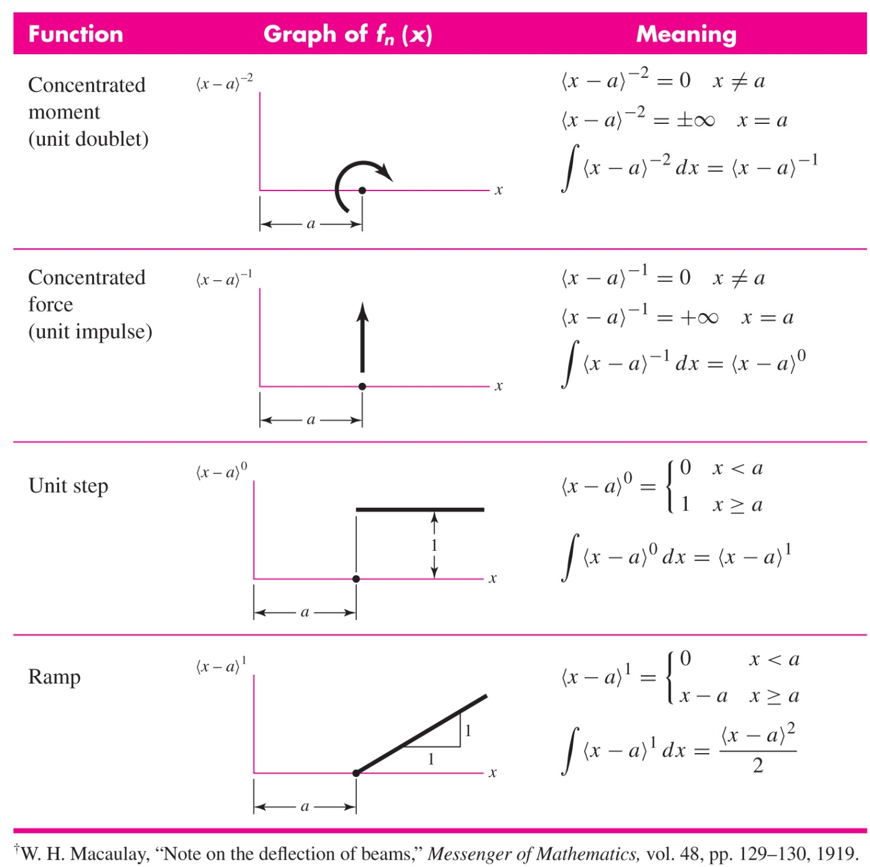
Singularity Functions
A notation useful for integrating across discontinuities
Angle brackets indicate special function to determine whether forces and moments are active
Table 3–1

Slide 17
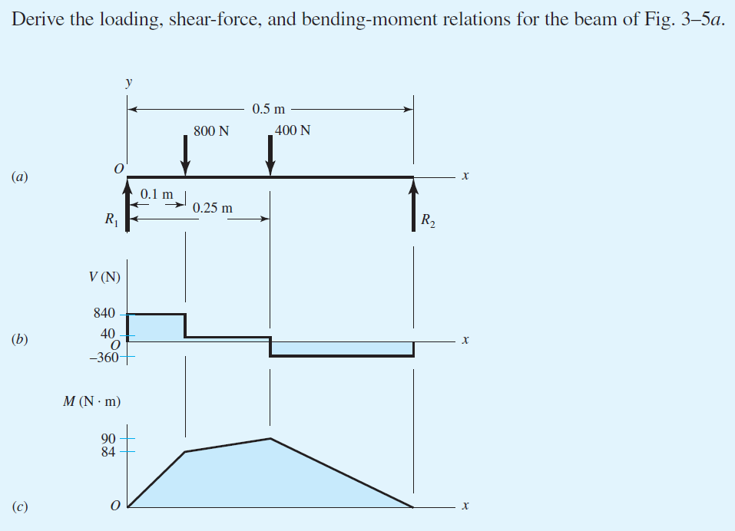
Example 3–2
Fig. 3–5

Slide 18

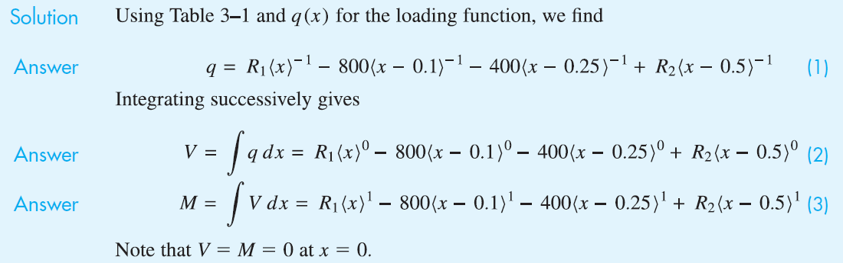
Example 3–2 (continued)
Answer
Answer
Answer

Slide 19
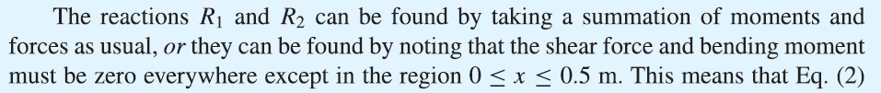
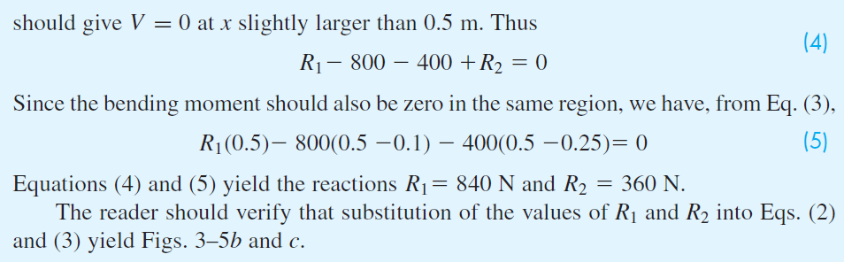
Example 3–2 (continued)

Slide 20
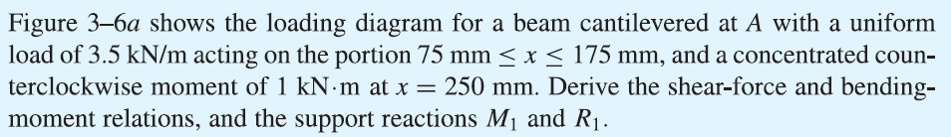
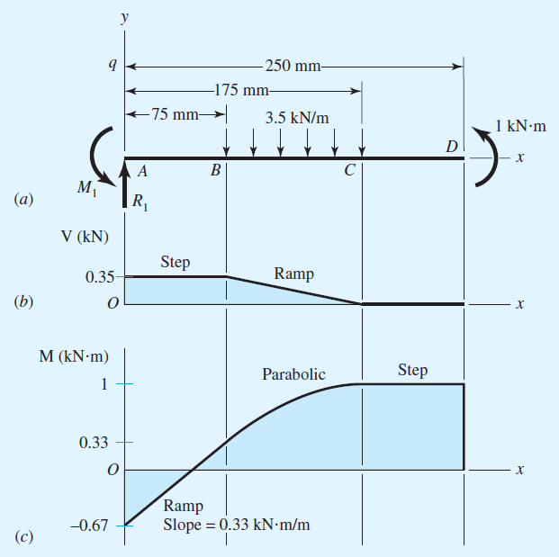
Example 3–3
Fig. 3–6

Slide 21
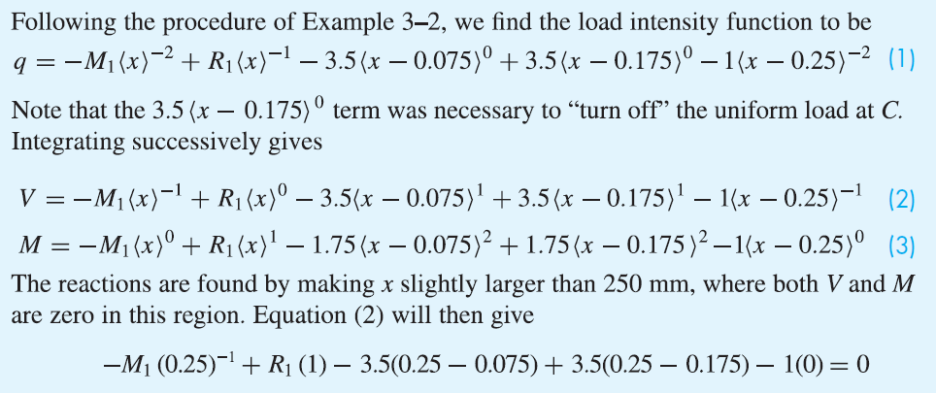
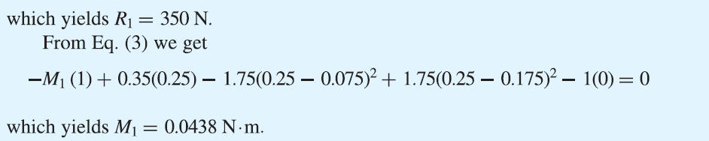
Example 3–3 (continued)

Slide 22
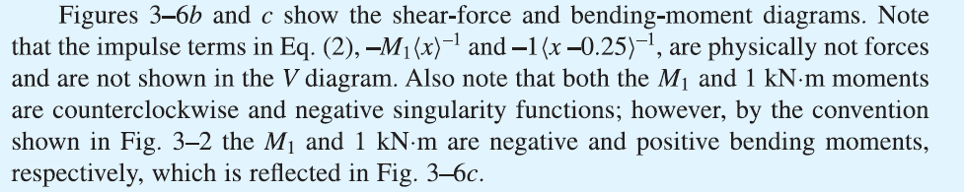
Example 3–3 (continued)
Fig. 3–6

Slide 23
Stress
Normal stress is normal to a surface, designated by σ
Tangential shear stress is tangent to a surface, designated by τ
Normal stress acting outward on surface is tensile stress
Normal stress acting inward on surface is compressive stress
U.S. Customary units of stress are pounds per square inch (psi)
SI units of stress are newtons per square meter (N/m²)
1 N/m² = 1 pascal (Pa)

Slide 24
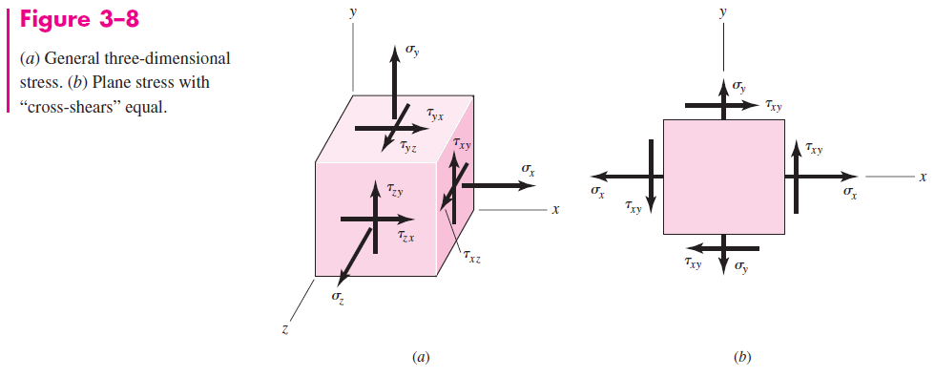
Stress element
Represents stress at a point
Coordinate directions are arbitrary
Choosing coordinates which result in zero shear stress will produce principal stresses

Slide 25
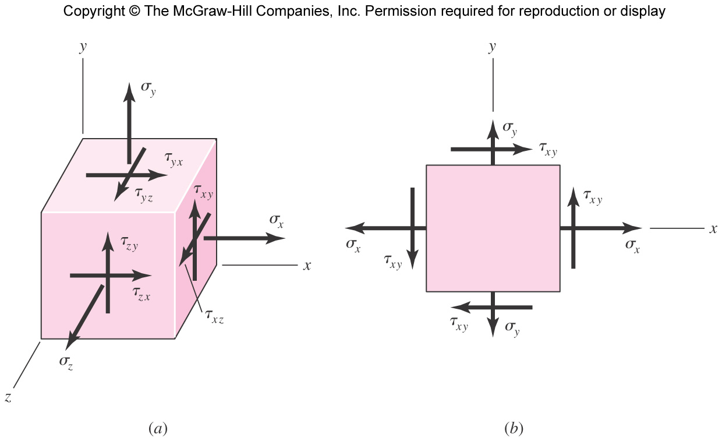
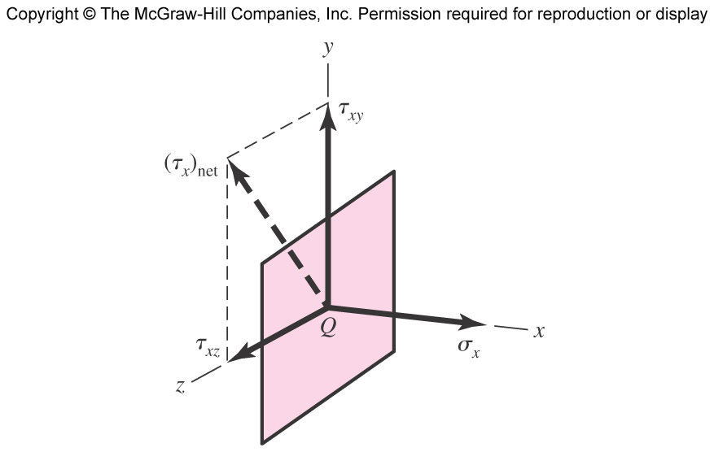
Cartesian Stress Components
Defined by three mutually orthogonal surfaces at a point within a body
Each surface can have normal and shear stress
Shear stress is often resolved into perpendicular components
First subscript indicates direction of surface normal
Second subscript indicates direction of shear stress
Fig. 3−8 (a)
Fig. 3−7

Slide 26
Cartesian Stress Components
Defined by three mutually orthogonal surfaces at a point within a body
Each surface can have normal and shear stress
Shear stress is often resolved into perpendicular components
First subscript indicates direction of surface normal
Second subscript indicates direction of shear stress

Slide 27
Cartesian Stress Components
In most cases, “cross shears” are equal
Plane stress occurs when stresses on one surface are zero
Fig. 3−8

Slide 28
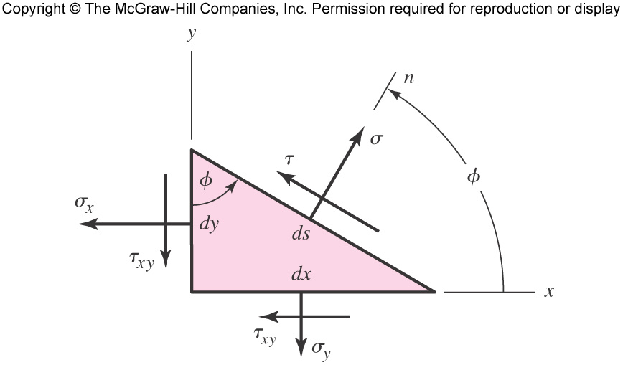
Plane-Stress Transformation Equations
Cutting plane stress element at an arbitrary angle and balancing stresses gives plane-stress transformation equations
Fig. 3−9

Slide 29
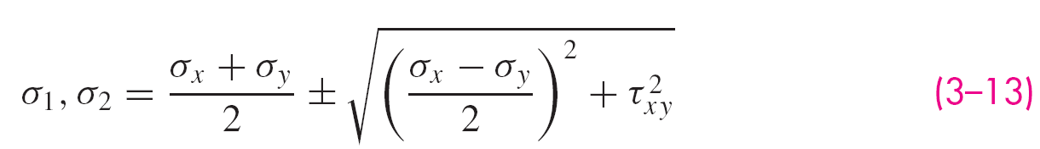
Principal Stresses for Plane Stress
Differentiating Eq. (3–8) with respect to φ and setting equal to zero maximizes σ and gives
The two values of 2φ_{p} are the principal directions.
The stresses in the principal directions are the principal stresses.
The principal direction surfaces have zero shear stresses.
Substituting Eq. (3–10) into Eq. (3–8) gives expression for the non-zero principal stresses.
Note that there is a third principal stress, equal to zero for plane stress.

Slide 30
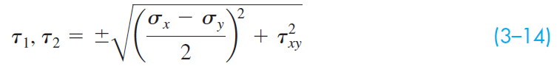
Extreme-value Shear Stresses for Plane Stress
Performing similar procedure with shear stress in Eq. (3–9), the maximum shear stresses are found to be on surfaces that are ±45º from the principal directions.
The two extreme-value shear stresses are

Slide 31
Maximum Shear Stress
There are always three principal stresses. One is zero for plane stress.
There are always three extreme-value shear stresses.
The maximum shear stress is always the greatest of these three.
Eq. (3–14) will not give the maximum shear stress in cases where there are two non-zero principal stresses that are both positive or both negative.
If principal stresses are ordered so that σ₁ > σ₂ > σ₃, then τ_{max} = τ_{1/3}

Slide 32
Mohr’s Circle Diagram
A graphical method for visualizing the stress state at a point
Represents relation between x-y stresses and principal stresses
Parametric relationship between σ and τ (with 2φ as parameter)
Relationship is a circle with center at C = (σ, τ) = [(σ _{x} + σ _{y})/2, 0 ] and radius of

Slide 33
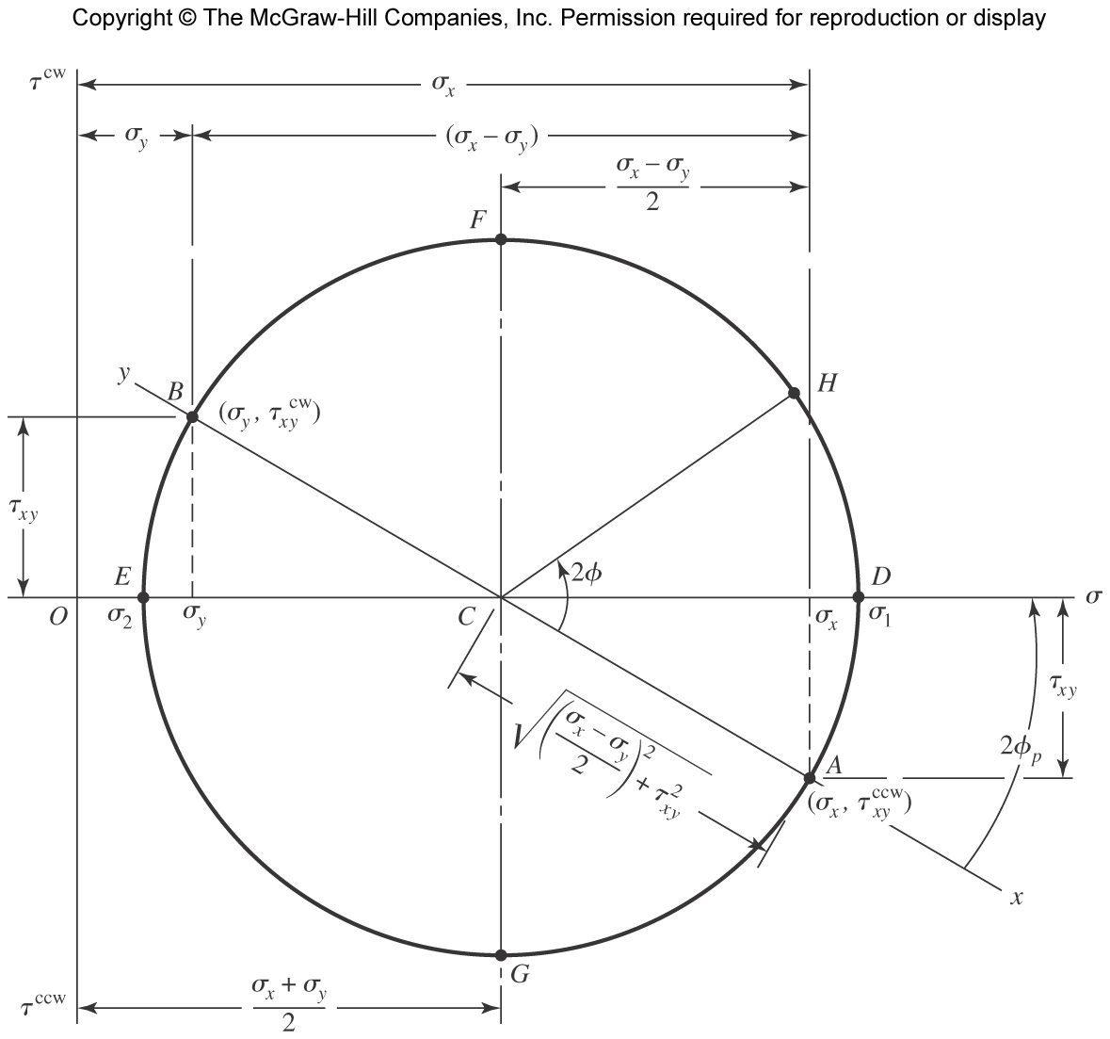
Mohr’s Circle Diagram
Fig. 3−10

Slide 34
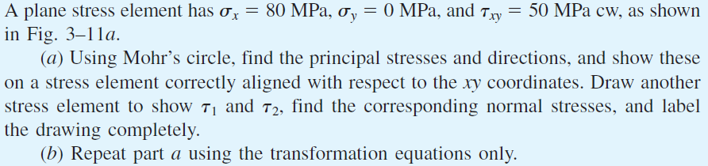
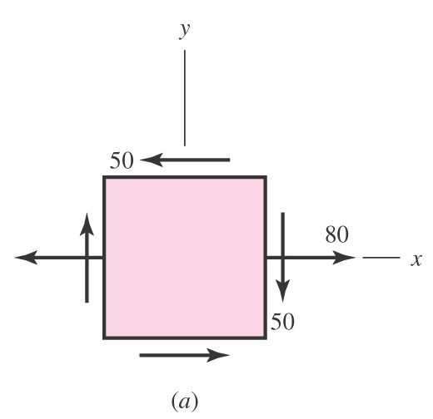
Example 3–4
Fig. 3−11

Slide 35
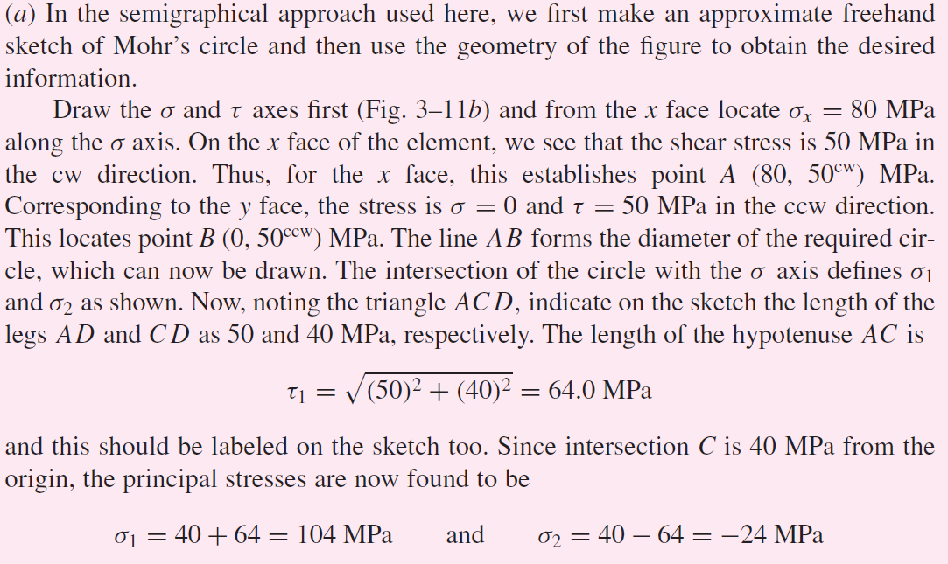
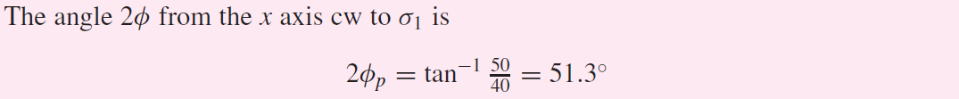
Example 3–4 (continued)

Slide 36
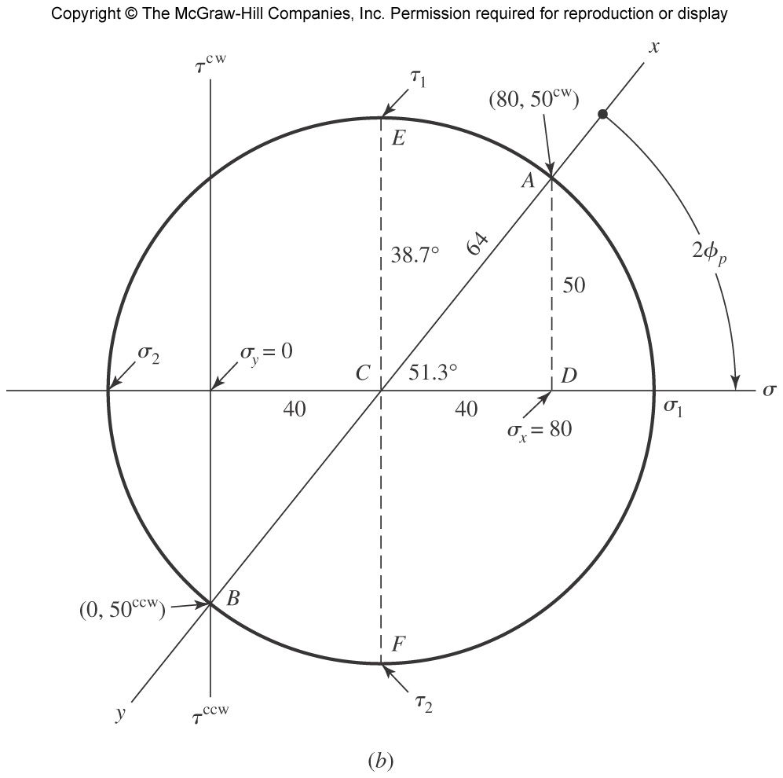
Example 3–4 (continued)
Fig. 3−11

Slide 37
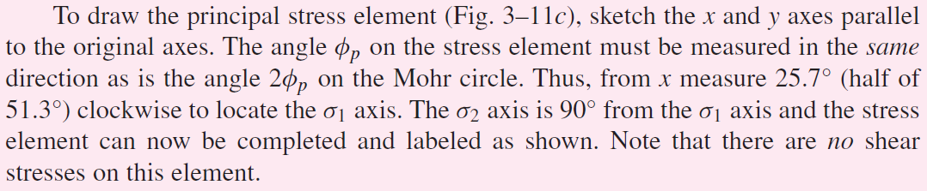
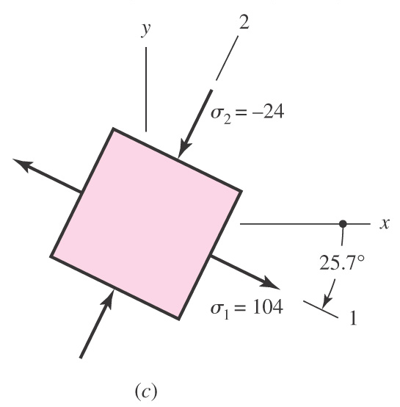
Example 3–4 (continued)
Fig. 3−11

Slide 38
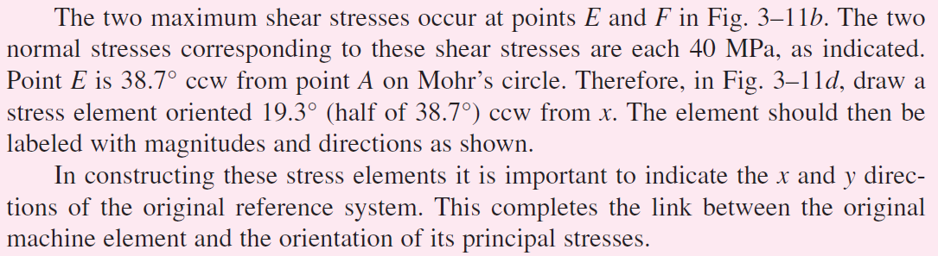
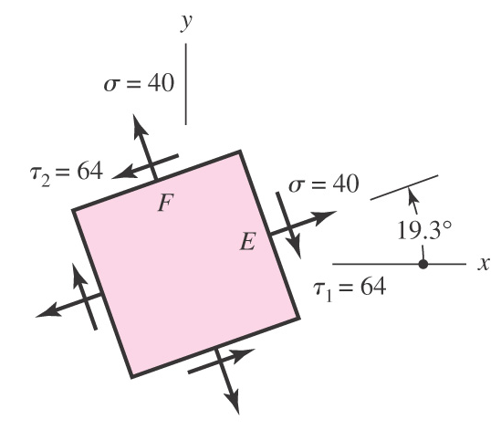
Example 3–4 (continued)
Fig. 3−11(d)

Slide 39
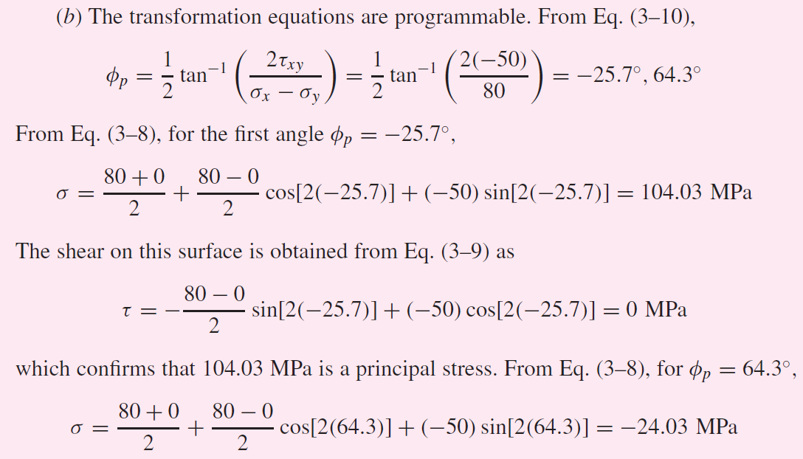
Example 3–4 (continued)

Slide 40
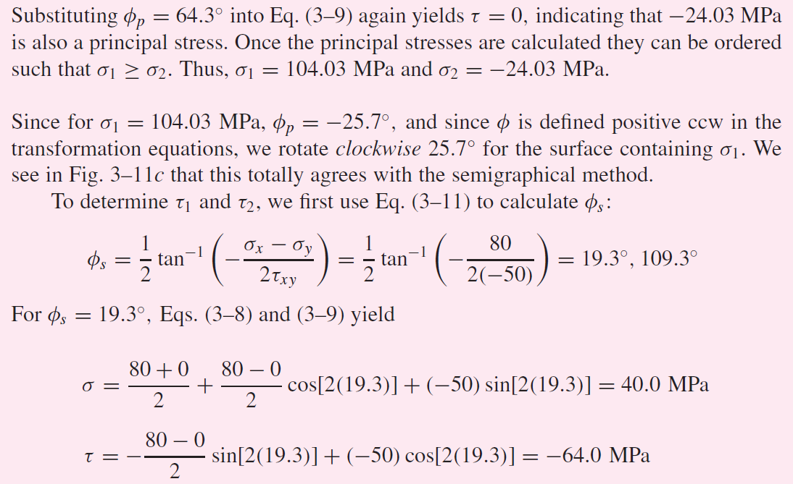
Example 3–4 (continued)

Slide 41
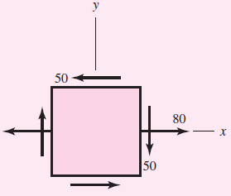
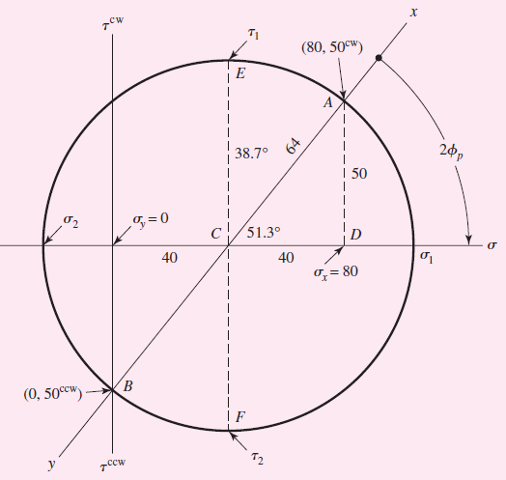
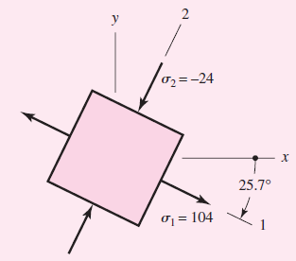

Example 3–4 Summary
x-y orientation
Principal stress orientation
Max shear orientation

Slide 42

General Three-Dimensional Stress
All stress elements are actually 3-D.
Plane stress elements simply have one surface with zero stresses.
For cases where there is no stress-free surface, the principal stresses are found from the roots of the cubic equation
Fig. 3−12

Slide 43
General Three-Dimensional Stress
Always three extreme shear values
Maximum Shear Stress is the largest
Principal stresses are usually ordered such that σ₁ > σ₂ > σ₃, in which case τ_{max} = τ_{1/3}
Fig. 3−12

Slide 44

Elastic Strain
Hooke’s law
E is Young’s modulus, or modulus of elasticity
Tension in on direction produces negative strain (contraction) in a perpendicular direction.
For axial stress in x direction,
The constant of proportionality n is Poisson’s ratio
See Table A–5 for values for common materials.

Slide 45

Elastic Strain
For a stress element undergoing σ_{x}, σ_{y}, and σ_{z}, simultaneously,

Slide 46
Elastic Strain
Hooke’s law for shear:
Shear strain γ is the change in a right angle of a stress element when subjected to pure shear stress.
G is the shear modulus of elasticity or modulus of rigidity.
For a linear, isotropic, homogeneous material,

Slide 47
Uniformly Distributed Stresses
Uniformly distributed stress distribution is often assumed for pure tension, pure compression, or pure shear.
For tension and compression,
For direct shear (no bending present),

Slide 48

Normal Stresses for Beams in Bending
Straight beam in positive bending
x axis is neutral axis
xz plane is neutral plane
Neutral axis is coincident with the centroidal axis of the cross section
Fig. 3−13

Slide 49



Normal Stresses for Beams in Bending
Bending stress varies linearly with distance from neutral axis, y
I is the second-area moment about the z axis
Fig. 3−14

Slide 50


Normal Stresses for Beams in Bending
Maximum bending stress is where y is greatest.
c is the magnitude of the greatest y
Z = I/c is the section modulus

Slide 51
Assumptions for Normal Bending Stress
Pure bending (though effects of axial, torsional, and shear loads are often assumed to have minimal effect on bending stress)
Material is isotropic and homogeneous
Material obeys Hooke’s law
Beam is initially straight with constant cross section
Beam has axis of symmetry in the plane of bending
Proportions are such that failure is by bending rather than crushing, wrinkling, or sidewise buckling
Plane cross sections remain plane during bending

Slide 52


Example 3–5
Fig. 3−15
Dimensions in mm

Slide 53

Example 3–5 (continued)

Slide 54


Example 3–5 (continued)

Slide 55

Example 3–5 (continued)

Slide 56


Example 3–5 (continued)

Slide 57

Two-Plane Bending
Consider bending in both xy and xz planes
Cross sections with one or two planes of symmetry only
For solid circular cross section, the maximum bending stress is

Slide 58



Example 3–6
Fig. 3−16

Slide 59



Example 3–6 (continued)
Fig. 3−16

Slide 60

Example 3–6 (continued)
Answer
Answer

Slide 61

Example 3–6 (continued)
Answer

Slide 62






Shear Stresses for Beams in Bending
Fig. 3−17

Slide 63


Transverse Shear Stress
Fig. 3−18
Transverse shear stress is always accompanied with bending stress.

Slide 64



Transverse Shear Stress in a Rectangular Beam

Slide 65

Maximum Values of Transverse Shear Stress
Table 3−2

Slide 66


Significance of Transverse Shear Compared to Bending
Example: Cantilever beam, rectangular cross section
Maximum shear stress, including bending stress (My/I) and transverse shear stress (VQ/Ib),

Slide 67
Significance of Transverse Shear Compared to Bending
Critical stress element (largest τ_{max}) will always be either
Due to bending, on the outer surface (y/c=1), where the transverse shear is zero
Or due to transverse shear at the neutral axis (y/c=0), where the bending is zero
Transition happens at some critical value of L/h
Valid for any cross section that does not increase in width farther away from the neutral axis.
Includes round and rectangular solids, but not I beams and channels

Slide 68



Example 3–7
Fig. 3−20

Slide 69


Example 3–7 (continued)
Fig. 3−20(b)

Slide 70

Example 3–7 (continued)
Fig. 3−20(c)

Slide 71


Example 3–7 (continued)

Slide 72

Example 3–7 (continued)

Slide 73

Example 3–7 (continued)

Slide 74

Example 3–7 (continued)

Slide 75

Torsion
Torque vector – a moment vector collinear with axis of a mechanical element
A bar subjected to a torque vector is said to be in torsion
Angle of twist, in radians, for a solid round bar
Fig. 3−21

Slide 76


Torsional Shear Stress
For round bar in torsion, torsional shear stress is proportional to the radius ρ
Maximum torsional shear stress is at the outer surface

Slide 77
Assumptions for Torsion Equations
Equations (3–35) to (3–37) are only applicable for the following conditions
Pure torque
Remote from any discontinuities or point of application of torque
Material obeys Hooke’s law
Adjacent cross sections originally plane and parallel remain plane and parallel
Radial lines remain straight
Depends on axisymmetry, so does not hold true for noncircular cross sections
Consequently, only applicable for round cross sections

Slide 78



Torsional Shear in Rectangular Section
Shear stress does not vary linearly with radial distance for rectangular cross section
Shear stress is zero at the corners
Maximum shear stress is at the middle of the longest side
For rectangular b x c bar, where b is longest side

Slide 79


Power, Speed, and Torque
Power equals torque times speed
A convenient conversion with speed in rpm
where H = power, W
n = angular velocity, revolutions per minute

Slide 80

Power, Speed, and Torque
In U.S. Customary units, with unit conversion built in

Slide 81


Example 3–8
Fig. 3−22

Slide 82




Example 3–8 (continued)
Fig. 3−23

Slide 83

Example 3–8 (continued)

Slide 84

Example 3–8 (continued)

Slide 85


Example 3–8 (continued)

Slide 86

Example 3–8 (continued)

Slide 87

Example 3–8 (continued)

Slide 88


Example 3–9
Fig. 3−24

Slide 89


Example 3–9 (continued)
Fig. 3−24

Slide 90

Example 3–9 (continued)
Fig. 3−24

Slide 91


Example 3–9 (continued)

Slide 92


Example 3–9 (continued)
Fig. 3−24

Slide 93

Example 3–9 (continued)

Slide 94


Closed Thin-Walled Tubes
Wall thickness t << tube radius r
Product of shear stress times wall thickness is constant
Shear stress is inversely proportional to wall thickness
Total torque T is
A_{m} is the area enclosed by the section median line
Fig. 3−25

Slide 95
Closed Thin-Walled Tubes
Solving for shear stress
Angular twist (radians) per unit length
L_{m} is the length of the section median line

Slide 96


Example 3–10
Fig. 3−26

Slide 97


Example 3–10 (continued)

Slide 98

Example 3–11
Solution

Slide 99


Open Thin-Walled Sections
When the median wall line is not closed, the section is said to be an open section
Some common open thin-walled sections
Torsional shear stress
where T = Torque, L = length of median line, c = wall thickness, G = shear modulus, and θ₁ = angle of twist per unit length
Fig. 3−27

Slide 100

Open Thin-Walled Sections
Shear stress is inversely proportional to c²
Angle of twist is inversely proportional to c³
For small wall thickness, stress and twist can become quite large
Example:
Compare thin round tube with and without slit
Ratio of wall thickness to outside diameter of 0.1
Stress with slit is 12.3 times greater
Twist with slit is 61.5 times greater

Slide 101


Example 3–12

Slide 102

Example 3–12 (continued)

Slide 103

Example 3–12 (continued)

Slide 104

Stress Concentration
Localized increase of stress near discontinuities
K_{t} is Theoretical (Geometric) Stress Concentration Factor

Slide 105


Theoretical Stress Concentration Factor
Graphs available for standard configurations
See Appendix A–15 and A–16 for common examples
Many more in Peterson’s Stress-Concentration Factors
Note the trend for higher Kt at sharper discontinuity radius, and at greater disruption
Fig. A–15–1
Fig. A–15–9

Slide 106
Stress Concentration for Static and Ductile Conditions
With static loads and ductile materials
Highest stressed fibers yield (cold work)
Load is shared with next fibers
Cold working is localized
Overall part does not see damage unless ultimate strength is exceeded
Stress concentration effect is commonly ignored for static loads on ductile materials

Slide 107

Techniques to Reduce Stress Concentration
Increase radius
Reduce disruption
Allow “dead zones” to shape flowlines more gradually

Slide 108


Example 3–13
Fig. 3−30

Slide 109


Example 3–13 (continued)
Fig. A−15−1

Slide 110


Example 3–13 (continued)

Slide 111


Example 3–13 (continued)
Fig. A−15−5

Slide 112

Stresses in Pressurized Cylinders
Cylinder with inside radius r_{i}, outside radius r_{o}, internal pressure p_{i}, and external pressure p_{o}
Tangential and radial stresses,
Fig. 3−31

Slide 113

Stresses in Pressurized Cylinders
Special case of zero outside pressure, p_{o} = 0
Fig. 3−32

Slide 114
Stresses in Pressurized Cylinders
If ends are closed, then longitudinal stresses also exist

Slide 115



Thin-Walled Vessels
Cylindrical pressure vessel with wall thickness 1/10 or less of the radius
Radial stress is quite small compared to tangential stress
Average tangential stress
Maximum tangential stress
Longitudinal stress (if ends are closed)

Slide 116

Example 3–14
Solution

Slide 117

Example 3–14 (continued)

Slide 118

Stresses in Rotating Rings
Rotating rings, such as flywheels, blowers, disks, etc.
Tangential and radial stresses are similar to thick-walled pressure cylinders, except caused by inertial forces
Conditions:
Outside radius is large compared with thickness (>10:1)
Thickness is constant
Stresses are constant over the thickness
Stresses are

Slide 119



Press and Shrink Fits
Two cylindrical parts are assembled with radial interference δ
Pressure at interface
If both cylinders are of the same material
Fig. 3−33

Slide 120



Press and Shrink Fits
Eq. (3–49) for pressure cylinders applies
For the inner member, p_{o} = p and p_{i} = 0
For the outer member, p_{o} = 0 and p_{i} = p

Slide 121
Temperature Effects
Normal strain due to expansion from temperature change
where α is the coefficient of thermal expansion
Thermal stresses occur when members are constrained to prevent strain during temperature change
For a straight bar constrained at ends, temperature increase will create a compressive stress
Flat plate constrained at edges

Slide 122

Coefficients of Thermal Expansion

Slide 123

Curved Beams in Bending
In thick curved beams
Neutral axis and centroidal axis are not coincident
Bending stress does not vary linearly with distance from the neutral axis
Fig. 3−34

Slide 124
Curved Beams in Bending
r_{o} = radius of outer fiber
r_{i} = radius of inner fiber
r_{n} = radius of neutral axis
r_{c} = radius of centroidal axis
h = depth of section
Fig. 3−34
c_{o}= distance from neutral axis to outer fiber
c_{i} = distance from neutral axis to inner fiber
e = r_{c} – r_{n}, distance from centroidal axis to neutral axis
M = bending moment; positive M decreases curvature

Slide 125

Curved Beams in Bending
Location of neutral axis
Stress distribution
Stress at inner and outer surfaces

Slide 126


Example 3–15
Fig. 3−35

Slide 127

Example 3–15 (continued)
Fig. 3−35(b)

Slide 128


Example 3–15 (continued)
Fig. 3−35(c)

Slide 129

Formulas for Sections of Curved Beams (Table 3–4)

Slide 130
Formulas for Sections of Curved Beams (Table 3–4)

Slide 131


Alternative Calculations for e
Approximation for e, valid for large curvature where e is small with r_{n} ≈ r_{c}
Substituting Eq. (3–66) into Eq. (3–64), with r_{n} – y = r, gives

Slide 132


Example 3–16
Fig. 3−36

Slide 133
Example 3–16 (continued)

Slide 134
Contact Stresses
Two bodies with curved surfaces pressed together
Point or line contact changes to area contact
Stresses developed are three-dimensional
Called contact stresses or Hertzian stresses
Common examples
Wheel rolling on rail
Mating gear teeth
Rolling bearings

Slide 135

Spherical Contact Stress
Two solid spheres of diameters d₁ and d₂ are pressed together with force F
Circular area of contact of radius a

Slide 136

Spherical Contact Stress
Pressure distribution is hemispherical
Maximum pressure at the center of contact area
Fig. 3−36

Slide 137
Spherical Contact Stress
Maximum stresses on the z axis
Principal stresses
From Mohr’s circle, maximum shear stress is

Slide 138

Spherical Contact Stress
Plot of three principal stress and maximum shear stress as a function of distance below the contact surface
Note that τ_{max} peaks below the contact surface
Fatigue failure below the surface leads to pitting and spalling
For poisson ratio of 0.30, τ_{max} = 0.3 p_{max} at depth of z = 0.48a
Fig. 3−37

Slide 139


Cylindrical Contact Stress
Two right circular cylinders with length l and diameters d₁ and d₂
Area of contact is a narrow rectangle of width 2b and length l
Pressure distribution is elliptical
Half-width b
Maximum pressure
Fig. 3−38

Slide 140


Cylindrical Contact Stress
Maximum stresses on z axis

Slide 141

Cylindrical Contact Stress
Plot of stress components and maximum shear stress as a function of distance below the contact surface
For poisson ratio of 0.30, τ_{max} = 0.3 p_{max} at depth of z = 0.786b
Fig. 3−39

